Slide 1
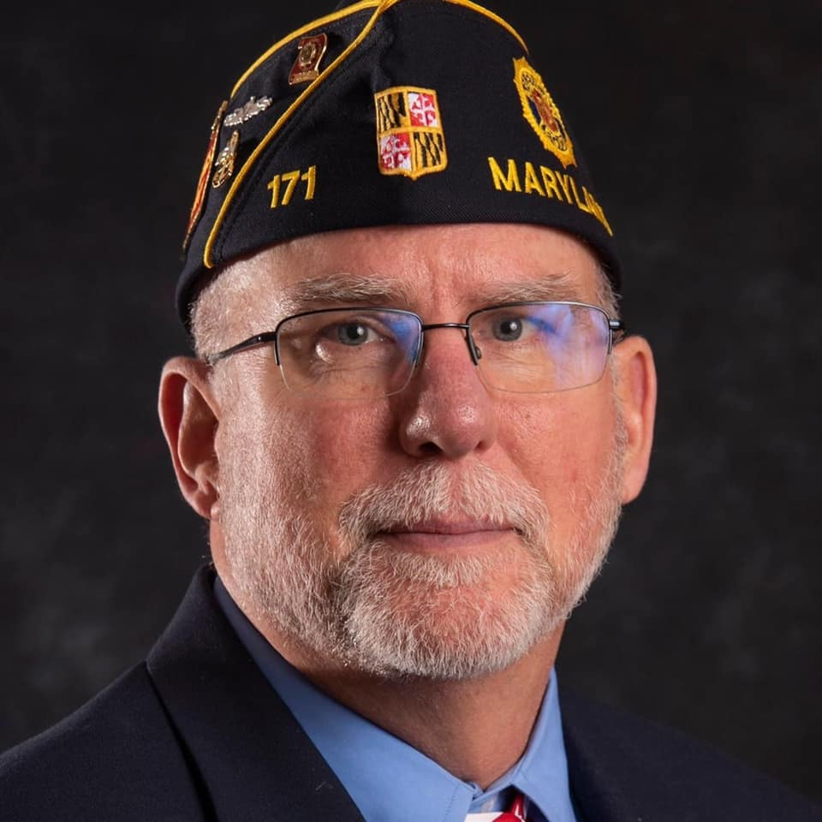
Consolidated Post Report (CPR)
Kevin Mook (MD)
Member Engagement Coordinator
Notes:
Good afternoon!
My name is Kevin Mook, I retired from the Navy in 2003 as a Chief Petty Officer and after bouncing around jobs as a defense contractor and Navy civilian I landed here in December 2018.
I’m a PUFL member of Damascus Post 171 in the department of Maryland. Prior to starting here, I was a post commander, adjutant and county commander.
While this is not supposed to be about me, I wanted you to know I’ve completed many CPRs for the post.

Slide 2
Consolidated
Post
Report
Notes:
The Consolidated Post Report (CPR) was established in 1975 in order to assist departments in the documentation of the various activities' posts have done during the twelve-month reporting period, June 1 through May 31. The CPR may be the most important document your post will complete each year. Your post’s information, combined with that of other posts, is used when the National Commander and others testify on Capitol Hill on behalf of The American Legion as required by the federal charter. Each post has a story to tell and when we speak collectively our strength is magnified.
Post adjutants are the key to how well The American Legion as a whole will be able to report to the American people its actual accomplishments for the past year.
Most posts receive a three-­‐part CPR report form for completion based on what is requested by the department. The first two copies go to department headquarters, and the third copy is to be retained by the post.
The CPR form covers participation in the Legion’s basic programs: Americanism, Children & Youth, Veterans Affairs & Rehabilitation, Veteran Employment and Education, Public Relations, National Security and Internal Affairs & Membership. For example, the form asks for number of funeral honors provided, if the post sponsors a baseball team, Junior shooting sports or scouts. Don’t be discouraged if the post doesn’t have something to report in every blank on the CPR because very few posts participate in every Legion program. Many outstanding posts devote their energies and resources to just two or three programs or activities.
Posts should confine answers to the allotted spaces. If they wish to go into a subject in further detail, include such information in a descriptive narrative attached to the report. This can cover a post’s accomplishments in program areas, including photos.
By mid-­‐August, National Headquarters expects to have a completed tabulation of all reports broken down by department.
Once the post has completed the annual report, it may be surprising how much the post has accomplished.
There is always the possibility a post’s reports will result in national recognition for one or more of its outstanding programs.

Slide 3
Report Flow
Post
Congress
Dept
Notes:
The reports are first compiled by local Posts and forwarded to Department Headquarters where they are compiled into one large report and then sent to National Headquarters. National Headquarters can then compile all Department Reports and draw in any reports completed on mylegion.org.
The compiled report is then sent to congress as a report on the activities of The American Legion for the previous year. This same information is used by the National Commander and other staff members as they testify before congress as mandated by the federal charter.

Slide 4
Each Post Has A Story
When we speak collectively, our strength is magnified
Notes:
Imagine the stories you have from your Post and I have from my Post and the other 12,540 Posts across the country.
With each and every report filed, our Strength is magnified!

Slide 5
Report Deadlines
Department HQ – No Later than June 1st **
National HQ – From Department July 1st
** Only used as an example, the department may have other dates or deadlines.
Notes:
All reports should be sent to department headquarters on or before the June 1st deadline, or sooner if the department has set an earlier date.

Slide 6
CPR Response Rates
Date | Posts | Submitted | Percent
2016 | 13,159 | 8,820 | 67%
2017 | 12,982 | 8,880 | 68%
2018 | 12,690 | 8,820 | 70%
2019 | 12,704 | 8,831 | 70%
Notes:
Nationally the numbers are not great.
In 2016 we had 8,820 posts completing the CPR out of 13,159 Chartered Posts. That’s still only 67% reporting!
In 2019 we had 8,831 posts reporting with less posts and it was still only 70% reporting.
The perception is that the report is too hard to complete or Posts think they have nothing to report.

Slide 7
We Can Help!
Notes:
Let me show you how we can help!

Slide 8

Where to get information
Individual Members
Checkbook
Records
Call Members
Meeting Minutes
Post Calendar
News Clippings
Notes:
So it's Memorial Day and you just finished the Community program and you are exhausted.
You look at the calendar and realize the CPR Report is due tomorrow and you haven't started yet - what should you do?

Slide 9
What To Report
Don’t cut yourself short
Donated hall rental costs
  Anything that benefits the community
  Taking part in a community event
  Don’t forget costs to run a program
Mailings, copies, phone calls, computer costs
Volunteer time
Notes:
First, don't panic, we will walk you through the process.
Check with your Chairpersons for their reports of activities of their committees and commissions.
Next, look at the bank records and see what kind of income and expenses you had throughout the year and how those entries fit into your report.
Next, query members and ask them about activities they may have participated in like Blood Donors; how many pints did they donate or VA Hospital volunteers; how many hours did they volunteer?
Go to the Historian and look through pictures and news clippings for information on community events.
Don't forget the Post calendar, it has most if not all of your activities recorded.

Slide 10
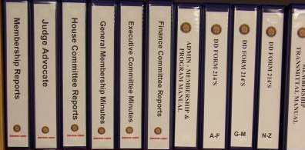
Document Programs
Notes:
Finally, don't forget to document your programs. Not only does it help in planning for next year, it allows you to collect the data you need to file a great CPR report every year.

Slide 11
Other Donations
Last section of report
Donations to other organizations
  Americanism community service
  Flags on Main Street
  Employment of disabled
Notes:
If you spend money on something or raise money … report it and don't forget in kind donations.
If you allow the Boy Scouts to use your hall for free but normally charge $100.00 for that same space to others; then you need to report the $100.00 in kind donation on your CPR.
Don't forget administrative costs for your programs, stamps, copies, phone calls and staff time are all reportable items.
Donations to other organization need to be reported also.
Employment of the Disabled, Flags on Main Street or Flags in the Schools. All of these should be report as activities and donations.

Slide 12
Most Important
Be proud to be a member of the world’s largest veterans service organization (VSO).
Let your post pride show through your CPR!
Notes:
Please be proud to be a member of the World's largest veterans service organization!

Slide 13
A Look at the Report
Report is broken down into sections
The first section is post demographic information
Department, post number, district number,
final membership count, city and state
Notes:
The first section is the Post information. It is pretty straight forward but note that the Department is usually your state unless you are outside of the contiguous united states.
The final membership number will be the number of paid members on the day you complete the report.

Slide 14

Veterans Affairs & Rehabilitation
Number of cases handled by the post service officer
Emergency financial aid provided to veterans
Number of volunteer hours at VA health-care facilities
Funds for VA Voluntary Service Program (VAVS)
Active VAVS Volunteers
Notes:
How many cases did your Post Service Officer handle?
How much money did you give for Emergency Aid to Veterans?
Number of Volunteers hours at VA Hospital
How much money did you give to the VA Voluntary Service Program
Do you have an active VA Voluntary Service coordinator?
How many VA Voluntary Service Volunteers do you have?

Slide 15
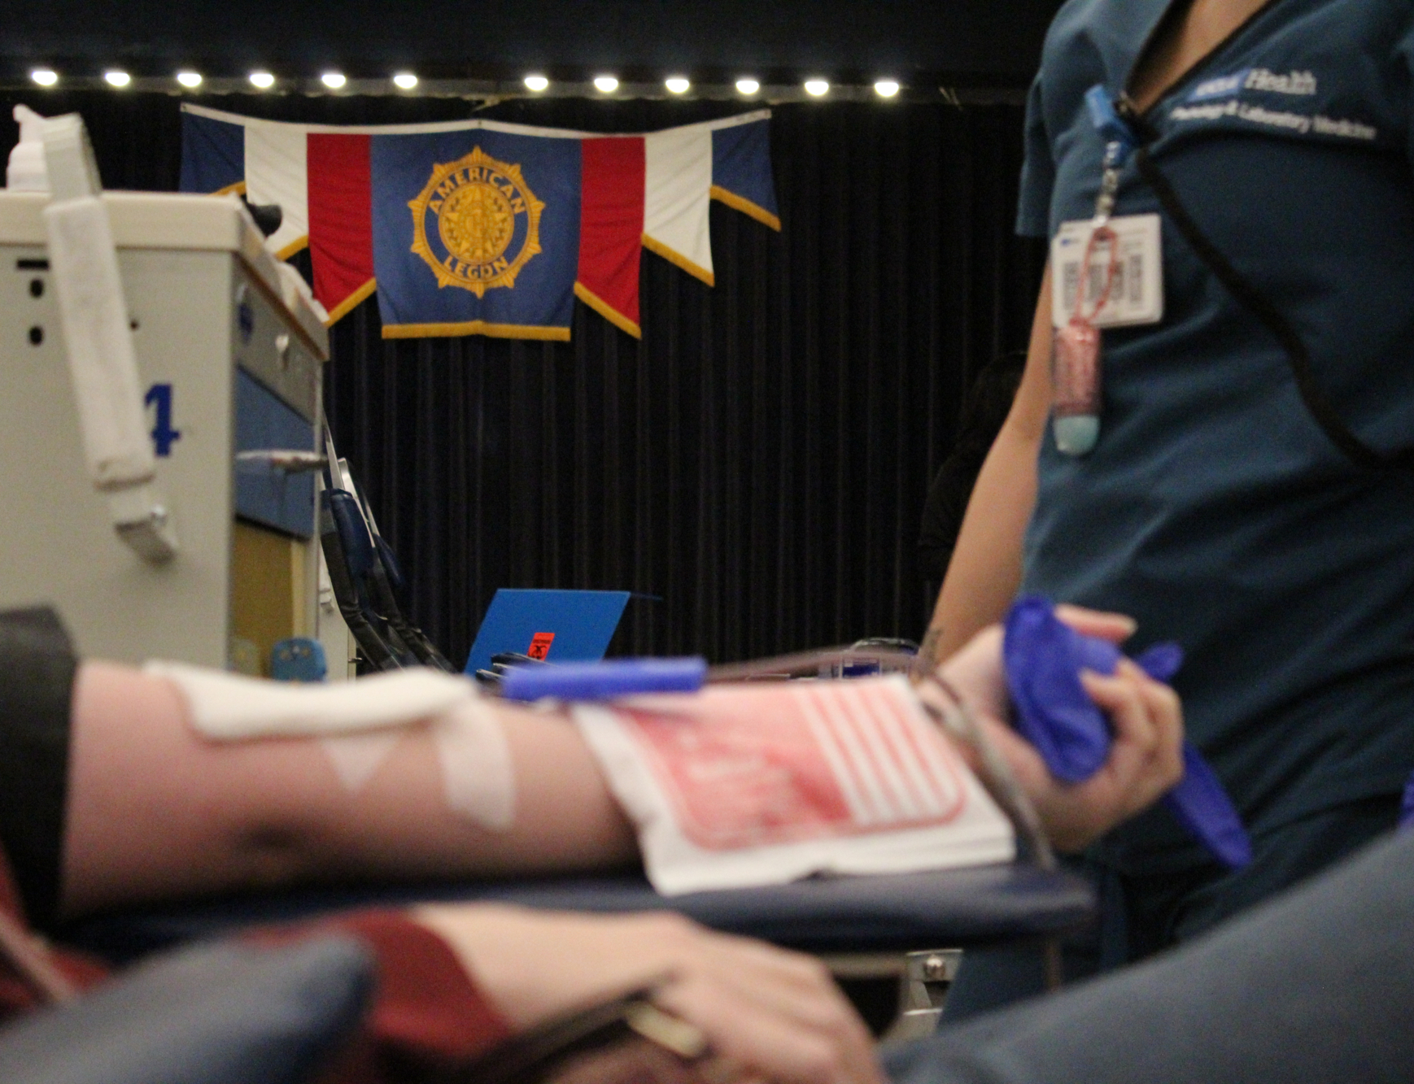
National Security
Blood donor program
ROTC medals
Crime prevention/
law & order program
Homeland security
Disaster relief
POW/MIA
Notes:
Do you have a Blood Donor Program?
How many pints of blood were donated?
How many of your donors are from the Post?
How many ROTC Medals did your post present?
Do you have a Crime Prevention Chairman?
Do you have a Fire Prevention Chairman?
Do you have a Homeland Security/Disaster Relief Chairman?
Do you have a POW/MIA Chairman?

Slide 16

Public Relations
Public Relations chair
Post publication
Website
Social Media accounts
Community events
Post mentions in media
Letters to the editor
Notes:
Do you have an active PR Chairperson?
Do you have a Post Publication?
Do you maintain a Web Site? MyLegion presence?
Do you have any Social Media Accounts? (Facebook, Twitter, LinkedIn, etc.)
Did you participate in 100th Anniversary Program?
How many times was your Post mentioned in the following:
Radio
TV
Cable Access
Newspaper (Stories)
Newspaper (Letter to Editor)

Slide 17
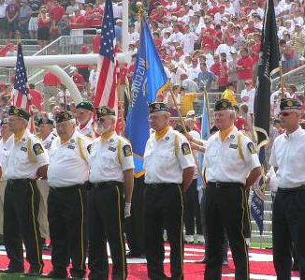
Ceremonial Honors For Veterans
Color guard
Rifle team
Number of funeral honors
Number of wake services
Amount spent on uniform group
Notes:
Did your Post have a Post Color Guard?
Did your Post have a Post Rifle Team?
How many Funeral Honors or Wake Services were provided?
How much money did your Post spend on your Uniform Group?

Slide 18
Veterans Employment & Education
Employment chairperson
Homeless veterans chairperson
Career fair participation
Referrals to LVER or DVOP
Veterans placed in jobs
Veterans placed in job training programs
Employ Older Worker Week
and Employer of the Year
Homeless veterans outreach
Award nominations submitted
  Employer of the disabled
  Employer of older workers
  Local Veteran Employment Rep (LVER)
  Disabled Veteran Outreach Program (DVOP)
  Employer of veterans
Notes:
Does your Post have an employment chairperson?
Does your Post have a Homeless Veterans chairperson?
Does your Post participate in career fairs?
How many veterans has your Post referred to Local Veteran Employment Representative (LVER) or Disabled Veterans’ Outreach Program (DVOP)?
How many veterans has your Post placed in employment?
How many veterans has your Post placed in job training program?
Does your Post promote programs like Employ Older Worker Week and Employer of the Year?
Has your Post submitted award nominations for any of the following:
Homeless Veterans Outreach?
Employer of the disabled?
Employer of Older Workers?
Local Veteran Employment Representative (LVER)?
Disabled Veteran Outreach Program (DVOP)?
Local office?
Employer of veterans, large size employer +200 employees?
Employer of veterans, medium size employer 50-200 employees?
Employer of veterans, small size employer 50 employees?

Slide 19
Americanism
Boys State
American Legion
Legacy Scholarship
Citizenship/naturalization
American Legion Baseball
Other athletic teams
Scouting
Oratorical Contest
School Award program
American Education Week
Notes:
Number of boys sponsored to Boys State?
What was the cost to the Post?
How much was donated to American Legion Legacy Scholarship?
Did your Post participate in citizenship/naturalization activities?
Did you sponsor an American Legion Baseball team?
What was the cost to the Post?
Did you sponsor other athletic teams?
What was the cost to the Post?
Did your Post sponsor a Boy Scout unit(s)?
How many Scouts in Legion Scouting?
How much money was donated to scouting activities?
Did your Post sponsor a local Oratorical Contest?
How many contestants participated?
What was the cost to the Post?
Did your Post participate in the School Award program?
How many awards were presented?
Did your Post participate in the American Education Week?
How many schools were assisted? What was the cost to the Post?
How many scholarships were awarded? How much was spent on scholarships?
How many hours of service was given to Education programs?
How much additional amounts were expended on Educational programs?

Slide 20
Americanism
Vets in the Classroom
Flag Education
Flag Day
Get Out The Vote
Veterans Day
Memorial Day
July 4th
American Legion Birthday
Four Chaplains Sunday
Community Service
Jr. Shooting Sports
Jr. Law Cadet
Notes:
Did you participates in "Vets in the Classroom"?
How many Flags presentations were made to local groups?
How much did it cost the post?
Did your Post participate in Flag Day?
Did your Post participate in Get Out The Vote?
Did your Post participate in Veterans Day?
Did your Post participate in Memorial Day?
Did your Post participate in July 4th Program?
Did your Post participate in American Legion Birthday?
Did your Post participate in Four Chaplains Sunday?
How many hours of service did you provide your Community?
How much did it cost the Post?
Did your Post conduct a Jr. Shooting Sports Program?
How many youth were involved?
How much did it cost the post?
Did your Post conduct a Junior Law Cadet program?
How many youth were involved?
How much did it cost the post?

Slide 21
Children & Youth
Children & Youth activities
Halloween Safety program
Health & Child safety program
Family Support Network
April is Children & Youth Month
Children’s Organ Transplant Association
Temporary Financial Assistance
American Legion Endowment Fund
Children’s Miracle Network Hospital
Special Olympics
Notes:
How many Children & Youth activities were held this year?
How much cash aid was given to benefit children?
What was the value of goods given to children (reasonable estimate)?
How many children were given aid (cash or goods)?
Did your Post participate in Halloween Safety program?
Did your Post participate in Health & Child Safety program?
Did your Post participate in the Family Support Network?
Did your Post participate in an April is Children & Youth Month program?
Did your Post participate in a Special Olympics event?
How much money was spent on administrative costs (paper, equipment, etc.)?
How much money was spent on parties, dinners, prizes and gifts?
How much money was spent on all other expenses?
How much money was spent on Children’s Organ Transplant Association?
How much money was spent on Family Support Network?
How much money was spent on Temporary Financial Assistance?
How much money was spent on American Legion Endowment Fund?
How much money was spent on Children’s Miracle Network Hospital?
How much money was spent on Special Olympics?
How much money was spent on all other child service charities?

Slide 22
Internal Affairs & Membership
American Legion Riders Chapter
Number of American Legion Riders
National Emergency Fund
Cost of troop support programs
Number of troop support volunteers
Number of troop support volunteer hours
The American Legion Amateur Radio Club
Sons of The American Legion
Notes:
American Legion Riders: has Riders Group
No. of Legion family members (TAL/SAL/ALA) in Riders group
How much donated to National Emergency Fund
Cost to post supporting Support Our Troops
Number of volunteer hours for Support Our Troops (Reconnect/Operation Outreach)
Does the post have The American Legion Amateur Radio Club (TALARC)?
All other fundraising not captured above

Slide 23
What YOU can do with your CPR
Fulfills the requirements for
The American Legion Congressional charter
Not just for Department and National
Helps recruit new members
Inspires existing members
Informs the community about your post
Not just a history book
Notes:
So why go through all the work to report all the great things you do every year?
While building this report does fulfill a requirement set forth in our Congressional Charter, the report is not just for the Department and National.
This report is a great tool for you as well! It can be used to recruit new members or remind your current members of why they joined in the first place. It can also be a great way to engage your community.
Think of some unique ways to use this information.

Slide 24
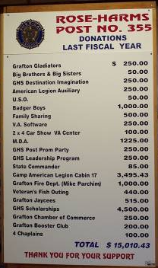
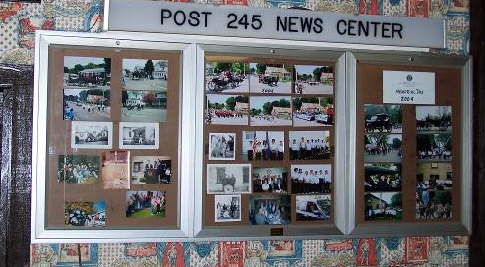
Proudly display your activities
Posters
Photo display
Notes:
Display the impact to your community through donations, photos and media clips throughout the year, and update it regularly.
Those who are featured will generate conversations that will advance awareness of the post and all it does.

Slide 25
Promotional tool
Share copies of your CPR to those who should know the impact your post has within the community
  Local media
  Civic leaders
  Membership team
  School leadership
Notes:
Finally, send a copy of your CPR to the local paper. Highlight some of the major events to draw them to the numbers. Let them know that this is an annual report that is filed with Congress each year as a report on YOUR community activities. Point out the affect that your Post has had on the Veterans, their families and their children.

Slide 26
CPR Via myLegion.org
Available late fall until July 1 of the membership year
  Complete in sections
  Departments receive copy
  Displayed on post myLegion page
Districts/Counties can view and print all reports submitted by their posts
Notes:
Submit your Consolidated Post Report on-line. This option will be available sometime in the late fall through July 1. National enters CPRs until all mailed forms are entered. The electronic form will be available until all entries are completed. However, you will want to check with your department for their reporting cutoff dates.
The electronic CPR can be completed in sections.
National emails all submitted CPRs to the appropriate department.
The CPR is also linked to the myLegion members page thus allowing them to see what activities the post supports.
Districts and Counties can view and print submitted reports from their sites.
FAQ: Why isn’t the CPR available the beginning of the membership year?
Answer: Each year the CPR is modified by National’s Internal Affairs & Membership Division. Once the modified form is submitted to IT, it will be posted to the site and made available in early November each year.

Slide 27
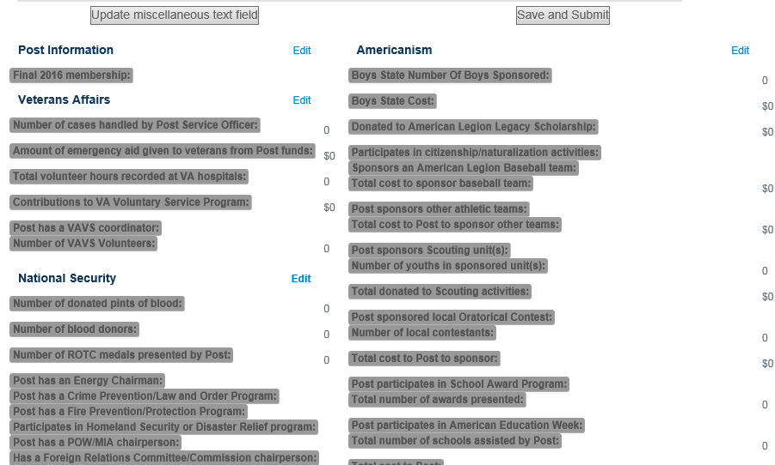
Notes:
The CPR will look like this. To enter data go to the section you want and select Edit.

Slide 28
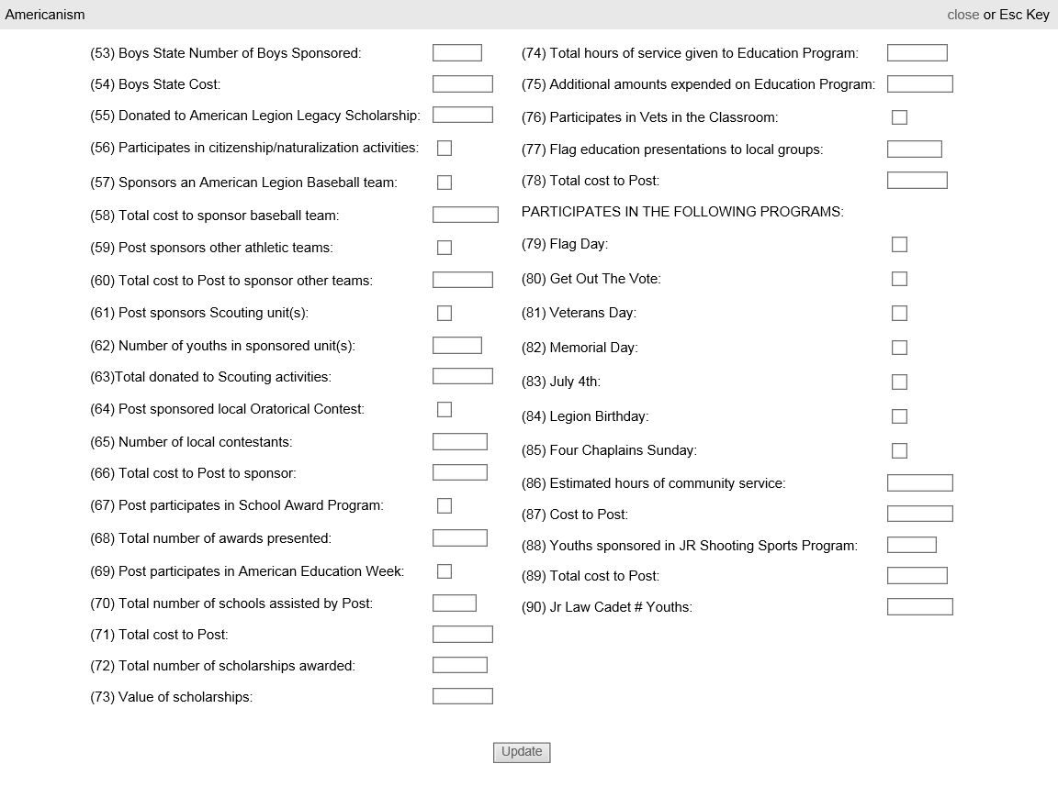
Notes:
Now the Americanism section is open to enter data. If you do not see all line items, you may need to adjust the Zoom settings on your internet browser. Once you have entered your data, click the Update button to save entered data and Escape key to exit. If you exit out of the page without hitting the Update button, entries will not be saved.

Slide 29
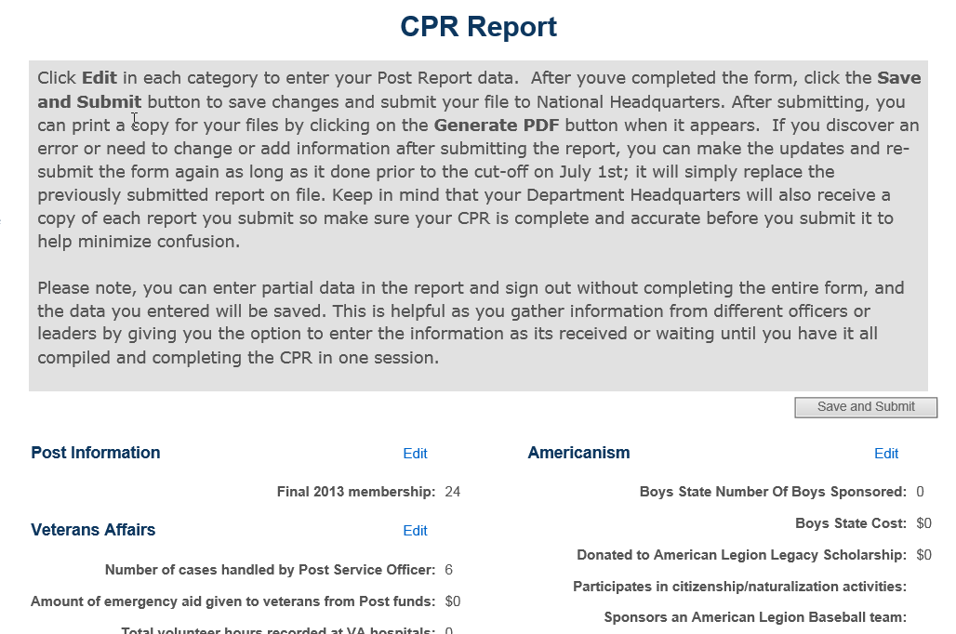

Notes:
Once you have completed the CPR, click Save and Submit. This submits the report to National Headquarters. However you can go back and make more entries until the close of reporting. Each time you submit the report it will replace the previous submission.
After clicking Save and Submit *** you can generate a PDF report to save and print.
FAQ: Can we get past CPR reports?
Answer: No, only the current year report is available. National does not store past reports. Check with your department for previous year reports.

Slide 30
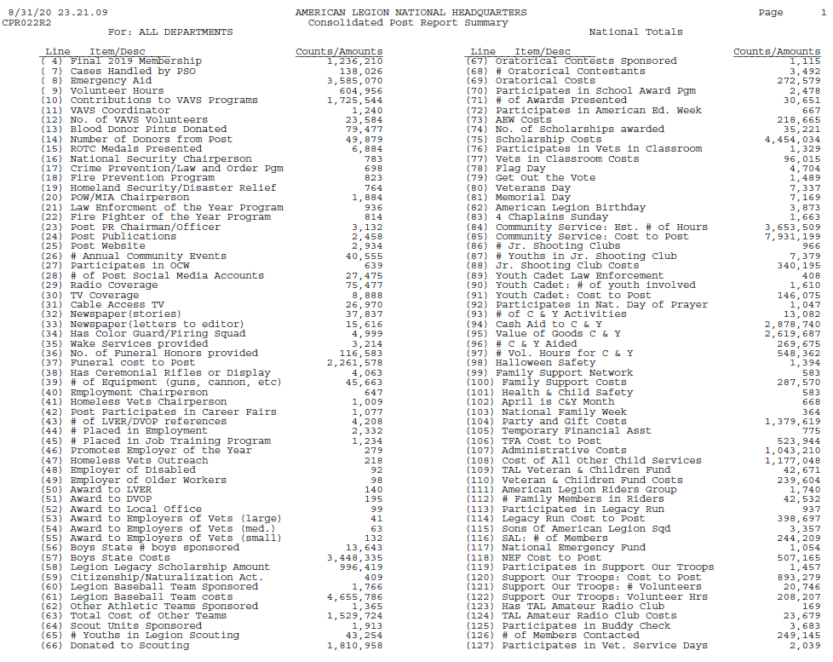
Notes:
Example of the national CPR report for 2019-2020.

Slide 31

Questions?

