Slide 1
National Membership Awards Points Program
NICK ARNETT
MEMBER ENGAGEMENT COORDINATOR
317.630.1326 narnett@legion.org
Notes:
Greetings everyone. This presentation will serve as a walkthrough of the awards that fall within the scope of the National Membership Awards Program.
I am Nick Arnett, Member Engagement Coordinator and Membership Awards Program Manager of the Internal Affairs & Membership Division of The American Legion National Headquarters. And I will serve as your presenter today.

Slide 2
www.legion.org/publications
Notes:
The prime resource for our awards program is the National Membership Awards Program Manual. This manual is updated and published every year by the Internal Affairs & Membership Division.
Departments are provided a copy each year and the manual can be viewed & downloaded as a PDF via www.legion.org/publications.
The National Membership Awards Program Manual is prepared and designed primarily to assist department and district membership teams in building a complete membership program.
It includes:
Material to help build a membership campaign.
A basic outline of important membership dates for the American Legion membership year.
Information on awards and national contests throughout the entire year.
Please keep in mind: The Trophies, Awards & Ceremonials Manual (or TAC Manual) is a separate manual. While there is a small amount of overlap concerning membership-based awards, this manual is intended to serve as a guidebook for navigating all the membership awards, many of which are not covered in the TAC Manual.

Slide 3
Notes:
Before we climb into all the different membership awards, we should take a moment to examine a couple schedules containing important membership dates, as they bear significant importance to the flow and function of the awards program.
The first schedule you should familiarize yourself with is the “Target Date Schedule”. Every year, a total membership goal is set for each department. In order to help departments gauge that progress throughout the course of the year, interval goals are established in the form of a percentage of that final goal, which are referred to as target dates. In this graphic, we can see the goal percentages with their correlating calendar date. Additionally, a short-hand identifier is commonly associated with the set target dates. For example, the 65% Target Date is often referred to as the Veterans Day Target Date, because that calendar date falls on or near Veterans Day every year.
Target dates are typically the second Wednesday of the month unless a holiday falls on that day or at the beginning of that week. Since Labor Day and Columbus Day fall on a Monday, the September and October target dates will be on a Thursday.
To maximize the December renewal notice, the January target date will be the third Wednesday of the month due to Martin Luther King Jr. Day.

Slide 4
Notes:
The next schedule in relation to the membership year is the “renewal schedule”. Essentially, this schedule drives renewal notices. For all practical purposes, it is used to describe when transmittals should reach national headquarters to prevent erroneous renewal notices from reaching members’ mailboxes. Transmittals not received by the cutoff date may not prevent a subsequent renewal notice from being delivered at or around the renewal date. Please note that renewals transmitted and received by the cutoff (which is also a national target date) will be updated prior to printing renewal notices, assuming they can be successfully scanned. Membership that must be hand-keyed (new members and renewals that cannot be scanned) will take longer to process. Please transmit as early and as often as possible in advance of the target dates to help avoid delays in processing.
All online membership processing transmittals submitted through mylegion.org by the close of business on the cutoff date will suppress printing of renewal notices.
Now that we have examined the necessary schedules, let’s take a look at the various membership awards that fall within the scope of our program.

Slide 5
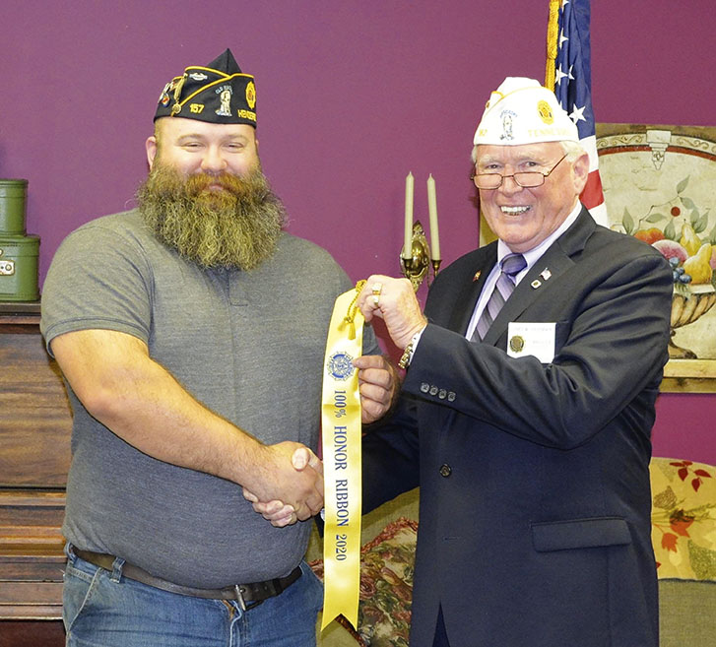
Post Advance Membership & Achievements
POST HONOR RIBBON
Ribbon for advance membership growth (as of 12/31)
CERTIFCATE OF MERITORIOUS SERVICE (ALL-TIME HIGH AWARD)
Certificate for advanced membership growth (as of 12/31)
FIVE OR MORE CONSECUTIVE YEARS ALL-TIME HIGH AWARD
Certificate (as of 12/31)
POST MEMBERSHIP RETENTION AWARD
Certificate for 90% member retention
(May Target Date)
POST REVITALIZATION RECOGNITION LETTER
Letter recognizing individuals assisting in post revitalization efforts (anytime)
Notes:
The first section of awards in this presentation are awarded to the post and address advance membership and other post achievements.
The POST HONOR RIBBON is awarded to posts whose membership for the current membership year (as of December 31) achieves an advance membership for the year about to begin equal to or greater than the final membership for the end of the year. For example, a post would need to secure more 2022 memberships than 2021 membership by December 31, 2021. Certification forms for Post Honor Ribbons must be submitted to the Membership Division by January 31. Department needs only to submit one form requesting ribbons for a total number of their posts that qualify; found on page 13.
The CERTIFICATE OF MERITORIOUS SERVICE ALL-TIME HIGH AWARD is a certificate awarded to those posts which have enrolled an advance membership for the year about to start equaling or surpassing the post’s previous all-time high membership by December 31 of that year. Department submits one form listing the posts who qualify for this certificate; found on page 14.
The FIVE CONSECUTIVE YEARS ALL-TIME HIGH AWARD is a certificate awarded to posts that has five or more consecutive years of all-time high membership. A minimum of five consecutive years is necessary to qualify, but a citation can be earned each year the post continues its all-time high performance after the fifth year. Department submits one form listing the posts who qualify for this certificate as well; found on page 15.
The POST MEMBERSHIP RETENTION award recognizes posts for their ability to renew their previous year’s membership. To qualify, the post must have at least the minimum number of members to maintain their post charter within their designated department and retain at least 90 percent of their previous year’s membership by the May target date. The accompanying certificate for this award will reflect retention categories of over 90, 95 and 100%. Department submits one form listing the posts who qualify for this certificate as well; found on page 31.
Departments may also request a recognition letter from the national commander to posts thanking and acknowledging those individuals who have assisted in the revitalization of their post. Department Adjutants should complete one form per post, which can be found on page 28.

Slide 6
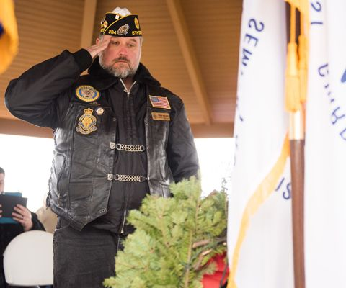
District Achievements & New Posts
District commander achievement award & honor ribbon
Certificate for commander, Ribbon f or district colors for growth (May Target Date)
DISTRICT COMMANDER 100% PIN
Pin & Certificate for commander for 100% (anytime)
DISTRICT COMMANDER NEW POST ACHIEVEMENT AWARD
Certificate for commander (May Target Date)
PIONEER AWARD
Certificate for individual key in post chartering (anytime)
NEW POST DEVELOPMENT PIN
Pin for members forming new posts (anytime)
Notes:
The next series of awards in this presentation are awarded to districts and their commanders.
All district commanders whose May target date membership exceeds the previous year’s membership by at least the number of posts in that district, will be awarded the District Commander Achievement Award. In addition, the district will receive a District Honor Ribbon for its district colors. Department adjutants should submit the form on page 19 to national by May 31.
District Commanders may also receive a cap/lapel pin and certificate if their district reaches 100% of the assigned district membership goal at any point during the year. Department adjutants may submit only one form if they choose for all their districts; found on page 27.
The DISTRICT COMMANDER’S NEW POST ACHIEVEMENT AWARD is available for District commanders who create new American Legion posts in their respective districts and have the new post’s temporary charter application on file at National Headquarters by the May target date. Department adjutants will need to complete the form on page 18 to award these district commanders.
Immediately after securing a post charter, a member may be nominated for THE AMERICAN LEGION PIONEER AWARD. This award is a way to recognize an individual who has made the greatest contribution in helping to charter a new post and ensure its successful operation. Departments simply need to complete the form on page 25 and can submit it at anytime.
The NEW POST DEVELOPMENT PIN is also available to any individual who assists with the initial start-up of a new post. Department adjutants may nominate volunteers at any time throughout the year by completing the form on page 28.

Slide 7
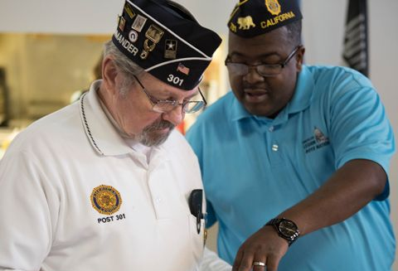
District Commander Race to the Top Competition
Highest district membership goal per category (March 31) and must be 100% to qualify
Winners in six district categories:
1st place: trip to National Convention
2nd place: $500
3rd place: $375
RTTT District Categories
Category I 85,000 or more members
Category II 65,000 to 84,999 members
Category III 40,000 to 64,999 members
Category IV 25,000 to 39,999 members
Category V 10,000 to 24,999 members
Category VI 9,999 or fewer members
Notes:
The pinnacle of district commander commendations falls at DISTRICT COMMANDER RACE TO THE TOP COMPETION.
This competition is divided into five categories based on membership of the district without regards to geographic locations. District commanders will compete within their respective categories based on their final membership year totals as of March 31. District must be at 100% to qualify and have the greatest membership percentage over the final previous year’s membership within their district category to win.
You may find the Race to the Top categories on this slide as well as on page 6 of the manual.
The top district commander for the national award will be selected from each of the five categories. Each first-place winner and guest are entitled to a trip to the national convention as distinguished guests of the national commander, including round-trip airfare, tickets to the National Commander’s Banquet, and hotel accommodations for six days and five nights. These district commanders also receive American Legion caps signifying they are Race to the Top winners and are awarded on stage at the national convention with ribbons for each of the district’s posts.
Second and third place awards are also presented in each category. Second-place winners are awarded checks of $500 and third-place winners are awarded checks of $375, but no additional ribbons will be awarded for the posts in those districts.
Departments must submit the RTTT certification forms to national by the April target date (page 16).

Slide 8
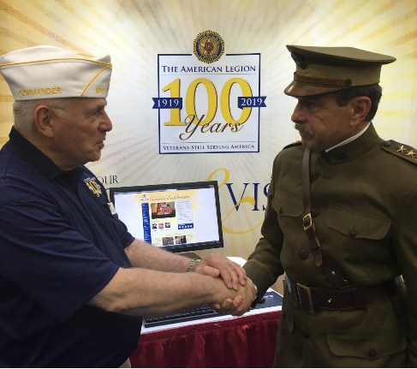
Department Advance Membership & Growth
Gen. john j. pershing honor award
Plaque for department with highest percentage of Post Honor Ribbons awarded (12/31)
FIVE OR MORE CONSECUTIVE YEARS ALL-TIME HIGH AWARD
Plaque for department (12/31)
HENRY D. LINDSLEY TROPHY AWARD
Plaque for department with highest percentage growth (3/31)
JERRY L. HEDRICK MEMBERSHIP AWARD
Plaque for foreign department with highest percentage growth (3/31)
GEN. HENRI GOURAUD TROPHY AWARD
Plaque for first department in each category exceeding goal
Notes:
The next set of awards are for departments for advance membership and growth.
The GENERAL JOHN J. PERSHING HONOR AWARD plaque is given annually to the department with the greatest percentage of posts receiving the Post Honor Ribbon for achieving 100 percent or more of their previous year’s membership enrolled for the coming year by December 31 AND having reported the achievement to National Headquarters no later than January 31.
All departments that by December 31 have an all-time high in membership for the current membership year (DMS included) that represents five or more consecutive years will receive a special plaque recognizing the number of consecutive years all-time high.
The Henry D. Lindsley Trophy is awarded to the department that has attained the highest percentage of membership over its previous year’s final membership, without counting DMS in either year by March 31. All membership transmittals used in determining the winner of this plaque must be part of the March 31 turn-in and must be received at National Headquarters during normal business hours on or before March 31.
The Jerry L. Hedrick Membership Award is awarded annually to a foreign department (i.e. not included among the state departments or District of Columbia) that has the highest percentage of members by March 31 compared with the total number of members in the department on December 31 of the preceding year. NOTE: This award was formerly named “The North Carolina Trophy”.
The General Henri Gouraud Trophy Award is a plaque awarded annually to that department in each of the six categories for first exceeding its national membership goal. These department categories are the same used for determining Big Twelve winners, with one winner to be determined in each category.

Slide 9
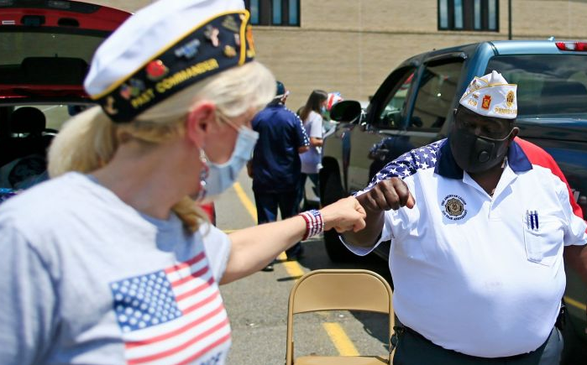
Big Twelve Competition
Departments qualify by reaching pledged percentage of goal (90% min.)
AND have highest percentage in each category are awarded (March Target Date)
Membership goal percentage (March Target Date)
Reimbursement for computer equipment
Winner: $2,000 (up to 6)
Runner-up: $1,000 (up to 6)
Big Twelve Department Categories
Category I 85,000 or more members
Category II 65,000 to 84,999 members
Category III 40,000 to 64,999 members
Category IV 25,000 to 39,999 members
Category V 10,000 to 24,999 members
Category VI 9,999 or fewer members
Notes:
Next stop on our membership awards tour, we have the BIG TWELEVE COMPETION awards.
The goals for Big 12 are set via bid system by departments, typically during the national roll call made at the Commanders’ and Adjutants’ Conference. Each department must maintain its own respective roll call pledge by having remittance forms and accompanying dues to equal the pledge made, received by National Headquarters during normal business hours on or before the March target date. The department in each category that has pledged the highest percentage, and meets this goal, are declared the winner. Transmittals in excess of the pledge, (of which must be at least 90%, not including DMS totals), will not alter the relative standing of the departments; however, defaulting among the Big Twelve by turning in a smaller number than pledged completely disqualify the department. As departments default, others in the same category move up. The winner in each category are eligible for reimbursements of computer equipment purchases up to $2,000. Department runners-up in all six categories are eligible for reimbursements of computer equipment purchases up to $1,000.
You may find the six Big Twelve categories broken down on this slide as well as on page 6 of the manual.
Note: All departments winning Big Twelve awards in March must submit legible cash register receipts and request reimbursement from the National Membership Division by September 30 or lose all entitlements.

Slide 10
Gold & Silver Brigade
GOLD BRIGADE: 50 recruits
First-Time Awardees
Second through Fourth time
Seventh time and beyond
Fifth Consecutive Year Award
Sixth Consecutive Year Award
Tenth Consecutive Year Award
SILVER BRIGADE: 25-49 recruits
Notes:
The next group of awards to cover today are designed to reward members for being top recruiters within the organization.
A Legionnaire who recruits 50 or more new members (excluding any transfers) into The American Legion by the May target date will qualify for enrollment in the elite Gold Brigade of The American Legion. These very special Legionnaires will be awarded unique gifts designating affiliation with the Gold Brigade. Also, special recognition will be given to those Legionnaires through special announcements at the national convention, in the Dispatch, online and other media.
The gifts awarded to a Gold Brigade recipient will depend on the number of times he or she has qualified for this award. Fifth, Sixth and Tenth consecutive years qualify only for their separate respective awards and require their own respective forms found in the Awards Points Program Manual.
First-time awardees receive a Gold Brigade patch, a Special Gold Brigade cap pin, a Gold Brigade certificate, and their choice of a Designer jacket, Polo shirt or Sweater with the Gold Brigade logo.
Second through fourth time awardees receive a Gold Brigade certificate, a “hash mark” for their Gold Brigade jacket sleeve, and their choice of a Designer jacket, Polo shirt or Sweater with the Gold Brigade logo.
Seventh time and beyond recipients received the same as the second through fourth time awardees with the addition of a $150 check.
Any recipient who has earned the Gold Brigade award for five consecutive years is eligible for the FIFTH CONSECUTIVE YEAR AWARD, which is signified by a distinctive blue Gold Brigade blazer. A Legionnaire may only qualify once every five years. NOTE: This Navy blue blazer replaces the gold blazer of previous years.
Any recipient who has earned the Gold Brigade Award for six consecutive years is eligible for the SIXTH CONSECUTIVE YEAR AWARD, which includes a $150 check, an American Legion cap with the label “Master Recruiter,” a Gold Brigade plaque, a cap pin and a “hash mark” for their Gold Brigade jacket.
Any recipient who has earned the Gold Brigade award for 10 consecutive years is eligible for the TENTH CONSECUTIVE YEAR AWARD, which includes the distinctive blue Gold Brigade blazer with the tenth-year Gold Brigade logo, a tenth-year cap pin, a “hash mark”, and Gold Brigade plaque. (This is a one-time award.)
THE SILVER BRIGADE AWARD: A Legionnaire who recruits 25 to 49 new members (excluding any transfers) into The American Legion by the May target date will qualify for this award. A silver pin and certificate will be awarded (page 24). NOTE: Silver Brigade and Gold Brigade awards cannot both be awarded to a recruiter during the same membership year.
Department adjutants must submit the appropriate certification forms for each gold/silver brigade nomination (found on pages 20-24 if the manual) to national headquarters by the last day of May (page 22).

Slide 11
Recruiter of the Year
DEPARTMENT RECRUITER OF THE YEAR
Certificate for individual with most new recruits within department (5/31)
NATIONAL RECRUITER OF THE YEAR
Individuals with the highest amount of new recruits across organization (5/31)
Winner: trip to National Convention, personalized ring
Runner up: $1,000 check and certificate
Third place: $150 check and certificate (10 awardees)
Fourth place: $100 check and certificate (15 awardees)
Notes:
Each American Legion post will have the opportunity to submit the name of the recruiter from that post who has signed up the highest number of new members for the membership year by the May target date for DEPARTMENT RECRUITER OF THE YEAR: . Department headquarters will supply certification forms to be completed by the post commander or adjutant and submitted to department headquarters by the May target date plus one week. Department adjutants will determine the top new member recruiter for their respective department and certify the winner to National Headquarters, on or before the last day of May. The top new member recruiter, properly nominated and certified from each department, will be awarded a framed certificate noting his or her accomplishment.
NATIONAL RECRUITER OF THE YEAR: The individual certified with the highest number of new members recruited from among all the departments will be declared National Membership Recruiter of the Year. The award includes a trip to the national convention: six days and five nights for the Legionnaire and guest, round-trip air transportation, hotel accommodations and reserved seating tickets to the National Commander’s Banquet for Distinguished Guests. (NROY also receives same additional prizes as RTTT winners, plus a personalized ROY ring.)
Monetary awards will be presented to the next highest 26 individuals: One $1,000 check ; 10 $150 award checks (third place); 15 $100 award checks (fourth place)
Note: Post adjutants must send this form Department adjutants must send this form to department headquarters. Department adjutants must nominate top recruiters and submit their nomination form (along with a list of the names & ID#s of the recruited) to national on or before the last day of May. (Form found on page 17). A new member is defined as any eligible veteran who was not a paid member in good standing for the previous members.

Slide 12
Target Date Points Program Award
Notes:
The Target Date Points Program Award is based upon a point system awarded to departments for completing specific membership milestones and achievements. Departments must qualify and accrue points for reaching membership target dates, chartering new posts, participating in the Reconnect Program, and for having winners & nominations for other specific awards. The department commander and department membership chairman may earn checks up to $1,000 based on this points system and an additional $1,000 is awarded if the department meets all target dates. Each department must accomplish 98% of its annual membership goal by the May target date via traditional methods to be eligible for this award. The membership office will record traditional accomplishments on the transmittals received and processed at National Headquarters by the close of the target date business day.
You may reference page 2 of the Membership Awards Points Manual, but here are the highlights of the points system:
Departments receive 100 points per the target date percentage number. For example: 5000 pts for 50% TD, 5500 pts for 55% TD, 6000 pts for 60% TD, etc.
However, departments not only receive 8000 points for hitting the January target date but also get a bonus of 500 points. This bonus increases to 1,000 pts if they hit 85% and 2,000 pts if they hit 90% by the January TD.
Departments received 100 points per newly chartered post but are no longer penalized -500 pts for charter cancelations.
No more than 5,000 points total may be awarded for reconnects for the year (which we will examine on the next slide).
Departments can receive points for their Big 12 placements and Race-To-The-Top winners, as well as points for nominations for Race-To-The-Top and Gold Brigade.

Slide 13
Notes:
Under most circumstances, an awards points update will be sent out to senior leadership the week following each target date.
For the sake of an example, here is the final awards points update for the 2020-2021 year. Only Department of Mexico qualified by achieving 98% by the May Target Date, therefore the department commander and membership chairman were awarded according to their point totals, which in this case was $1,000.00. That department also met all the target dates for the membership year, so those leaders received an additional $1,000.00.
And any department that met all of the year’s target dates will also be eligible for the ALL TARGET DATES CERTIFICATE and that form can be found on page 26.

Slide 14
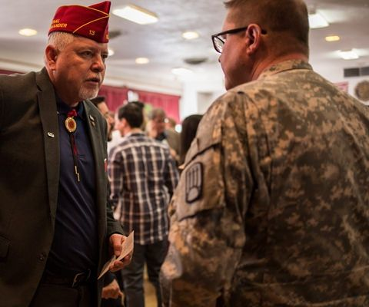
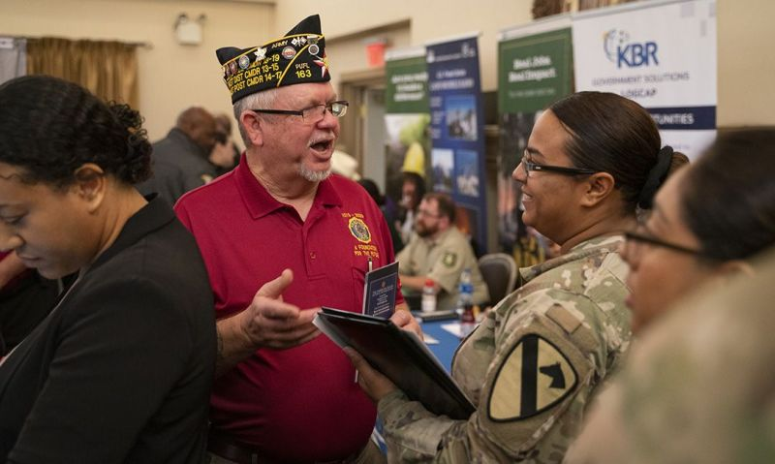
Reconnect
Interaction with military showing programs & services
Points towards TARGET DATE POINTS PROGRAM AWARD (6/30)
Minimum 100 points per event
Maximum 5000 points total per year
Last points possible!
Notes:
A RECONNECT is a DoD initiative meant to “reconnect” our country with its military. A RECONNECT effort is any face-to-face communication between military installations and American Legion posts, districts/counties or departments to showcase their many programs and services. Departments that do not currently report their reconnect efforts are strongly encouraged to do so. A minimum of 100 points will be awarded for each reconnect effort until June 30. Additional points may be awarded for more complex efforts lasting multiple days, involving other entities and demonstrating additional programs or services. A maximum of 5,000 points may be awarded to each department in a single membership year. Reconnect points are the last points to be tabulated for the Target Date Points Program Award. Winners are announced and checks are mailed after July 1. Any reconnect efforts dated July 1 or later will have those points applied towards the next year’s awards points totals.
In order to get credit for Reconnect, department adjutants must complete the form found on page 30, along with a description of the reconnect event which took place. Departments may duplicate the form or provide attachments for multiple events, as necessary.

Slide 15
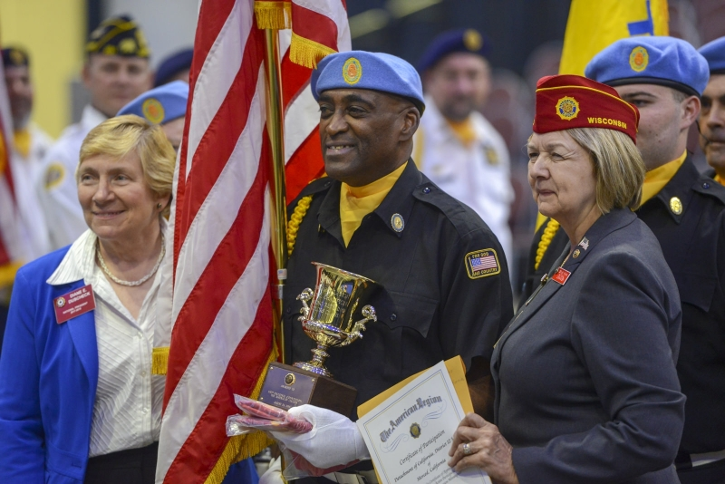
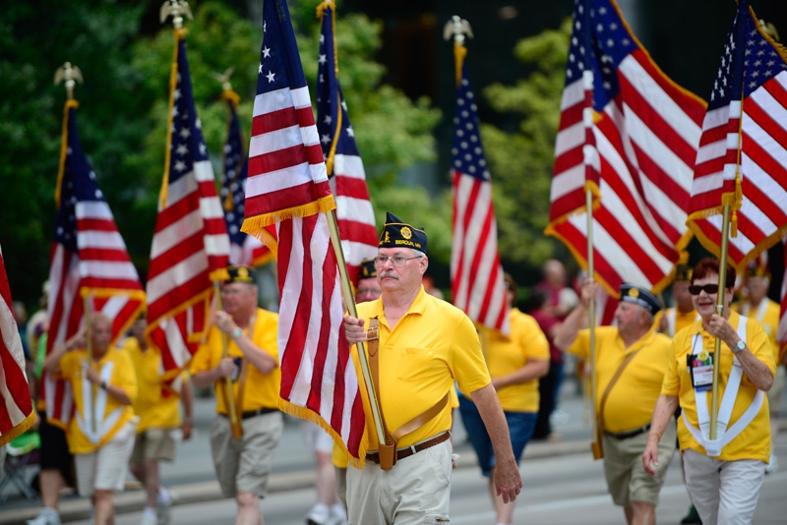
National Convention
NATIONAL CONVENTION HOUSING CUTOFF
Department housing determined by membership (May Target Date)
NATIONAL CONVENTION PARADE POSITION & CONVENTION HALL SEATING
Position & seating determined by department standings (June Target Date)
O.L. BODENHAMER TROPHY AWARD
Domestic Department designated to lead parade (June Target Date)
NATIONAL CONVENTION DELEGATE STRENGTH
(Delegate Strength Date)
Notes:
Last but not least, we have our awards pertaining to national convention & associated activities.
Department housing at the national convention will be determined according to membership standings from transmittals received at National Headquarters during normal business hours on or before the May target date.
Seating in the national convention hall is determined based on the department’s standing as of Flag Day membership report. DMS-acquired members will not be considered in determining convention hall seating or parade position (unless indicated otherwise).
National convention parade position is according to the following order of priority:
- Foreign departments , followed by:
- The O.L. Bodenhamer Trophy winner, awarded to the department whose standing is No. 1 on the Flag Day (June 14) membership report, followed by:
- Domestic departments that have achieved an all-time high (DMS included) for the current year by the June 14 membership report, in the order obtained, followed by:
- Domestic departments that have achieved an all-time high (DMS included) for the previous year in order of consecutive years of achievement, followed by:
- Domestic departments in order of their appearance on the June 14 membership report (DMS not included), followed by:
The host department.
Delegate strength is determined by total membership, including DMS members, in the hands of the national treasurer 30 days prior to the national convention. Total number of delegates for each department is based on five delegates at large, one delegate for each 1,000 members or major fraction thereof, and the members of the National Executive Committee.
National Headquarters must receive transmittals for delegate strength during normal business hours on or before 30 days prior to the beginning of National Convention.

Slide 16
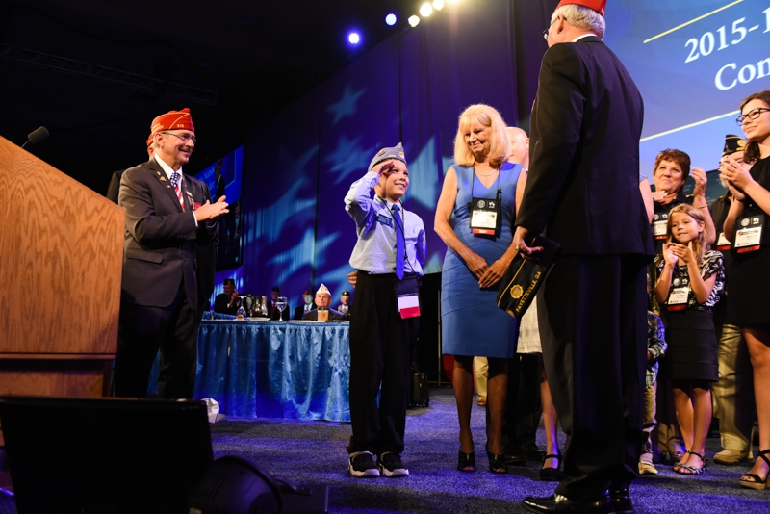
National Convention
DEPARTMENT COMMANDER OF THE YEAR AWARD
Certificate for any department commander meets/exceeds 100% by May Target Date (May Target Date)
DEPARTMENT COMMANDER ALL-TIME HIGH AWARD
Rings for commander, adjutant and membership chairman (DMS included) (Delegate Strength Date)
DEPARTMENT HONOR RIBBON
Any department surpassing previous year's membership (National Convention)
Notes:
Any department commander who meets or exceeds the 100 percent goal by the May target date will receive a framed certificate, presented by the national commander at the national convention. NOTE: This award does not include a trip to the national convention for Department Commander of the Year.
Specially cast all-time-high rings will be awarded to the commander, adjutant and membership chairman of each department attaining a new all-time-high membership (DMS included) for the current membership year by 30 days prior to the national convention (Delegate Strength Date). The national commander reserves the right to award a different but similar award to any commander, adjutant or membership chairman who has already received an all-time-high ring.
Each department equaling or surpassing its previous year’s final membership by opening day of the national convention will receive an honor ribbon for its department colors.

Slide 17
Parting Words & Clarifications…
Forms can be mailed directly to:
The American Legion National Headquarters,
Attn: Membership Division,
P.O. Box 1055, Indianapolis, IN 46206
They can also be faxed to (317) 630-1413 or emailed to membership@legion.org.
Post, department and national recruiter forms have been incorporated into one form. Departments may make copies as needed.
DMS memberships will not count for points and awards unless stated. DMS-acquired members will count toward all-time high awards and national convention delegate strength.
All target date accomplishments are based on each department’s total membership on the transmittals received and successfully processed at National Headquarters by close of business on the target date. Transmittals with incorrect data or insufficient funds will not be counted.
A new member is defined as any eligible veteran who was not a paid member in good standing for the previous members.
Notes:
That concludes our walkthrough of all the awards within the scope of the National Membership Awards Program. But before we finish today, I would like to clarify and provide guidance on just a few more items:
Forms can be mailed directly to National Headquarters at the address provided, however they may also be faxed or emailed which will ensure shorter processing times.
Departments should make as many copies of the forms as needed.
DMS memberships will not count for points and awards unless stated. DMS-acquired members will count toward all-time high awards and national convention delegate strength.
All target date accomplishments are based on each department’s total membership on the transmittals received and successfully processed at National Headquarters by close of business on the target date. Transmittals with incorrect data or insufficient funds will not be counted.
For clarification: a new member is defined as any eligible veteran who was not a paid member in good standing for the previous members.
Departments, districts and posts are encouraged to establish incentive programs to further growth and post development within the American Legion family.
The Membership Awards Points Manual can be downloaded from The American Legion’s website and sent electronically. legion.org/publications. All questions can be directed to membership@legion.org or by calling (317) 630-1326.

Slide 18
Questions?
This institution is an equal opportunity provider.
Notes:
Do we have any questions regarding the National Membership Awards Program?
Email questions to membership@legion.org or give us a call at (317) 630-1330.

