Slide 1
Americanism and
Children & Youth

Slide 2

Americanism Commission
Oversees two foundational pillars:
Americanism
  Programs that provide citizenship and youth development
Children & Youth
  Programs that provide a hand-up
All of which rely upon volunteer support to recruit, train, plan, coordinate, support, and execute.
Notes:
The Americanism Commission of the American Legion has a large mandate. We oversee two of the four pillars of the founding pillars of The American Legion, Americanism and Children & Youth.
We are often asked about the differences between these two and the best way to put it. Americanism programs work to develop citizenship, pride in nation, and develop the youth of today who will lead American tomorrow. Children and Youth programs, instead, provides a hand-up to those in need.
In the next few slides, we will take at look at them further.

Slide 3
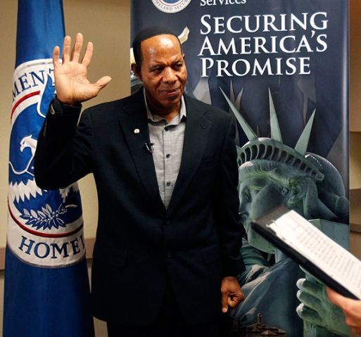
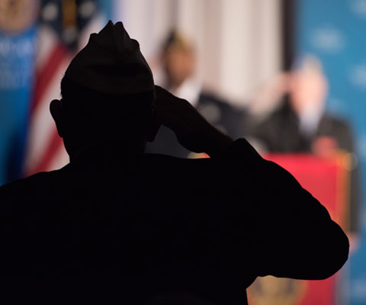
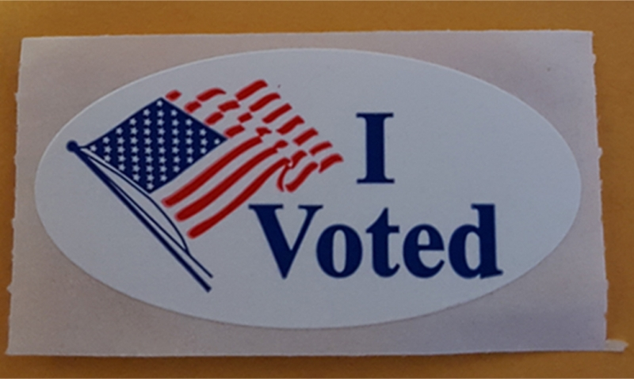

Citizenship
Get Out the Vote
Flag education and etiquette
Naturalization and assimilation
Notes:
Citizenship.
These programs promote patriotism among the citizenry. The American Legion works to promote every citizen to vote in every election. Legionnaires across the nation volunteer to work at polls, get people to the polls, and work to ensure that everyone is able to exercise their right to vote.
Since the early twentieth century the American Legion been the foremost proponent of Flag Education and etiquette. Developing what became the Flag Code and we continue to champion Flag Protection and ensuring that average citizens respect the flag through education programs and interaction with our legislative partners in Washington, D.C.
Post homes across the country work to ensure that legal immigrants are able to naturalize and integrate into American society daily. These programs are primarily led by those blue-cap Legionnaires who are working at the community level.

Slide 4
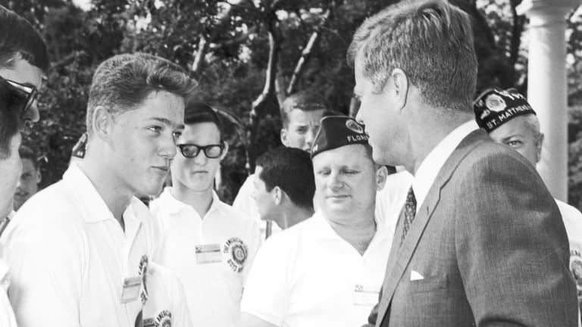

Youth Development
Baseball
Boys State/Nation
Junior Shooting Sports
Oratorical Contest
Notes:
Youth Development.
These activities span a range of areas: sport, academics, and outdoor activities have been around for decades. While some see these as a means of providing scholarship monies to youth, it is so much more.
You don’t get more American than baseball and ALB has been around since 1925. Enduring through the depression and wars, they have many MLB players over the years in their alumni ranks.
Boys Nation, where the young leaders receive an education on the structure and function of federal government, has been around since the end of World War II. However, it has its origins in the Boys State programs that sprung up at the department or state level since 1935.
Junior Shooting sports is unique in that while departments have parallel programs they do not feed into the national tournament, which meets at the US Olympic Center in Colorado Springs. There youth compete on the same range surrounded by Olympic Athletes who compete in the same disciplines.
Since 1938, the Oratorical program has presented participants with an academic speaking challenge that teaches important leadership qualities, the history of our nation’s laws, the ability to think and speak clearly, and an understanding of the duties, responsibilities, rights and privileges of American citizenship.

Slide 5
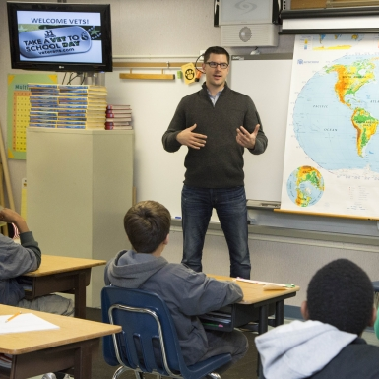
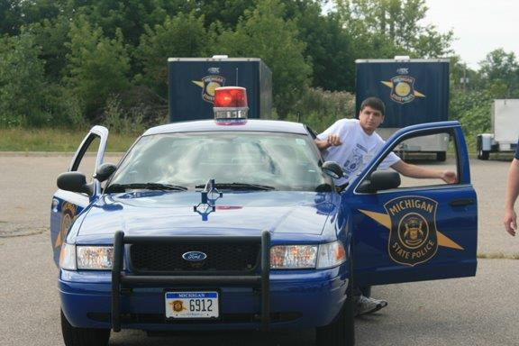

Youth Development (Cont.)
Youth Cadet Law Enforcement
Scouting
Youth Education
  Scholarships
  School Award Medal Program
  Veterans in the Classroom
Notes:
Youth Development (cont.)
Youth Cadet Law Enforcement is one of the newer activities at The American Legion. It provides first-hand experiences and insight into the operations of law enforcement agencies. The program also affords these highly motivated young people an opportunity to consider law enforcement as a potential career choice. We are currently cultivating more departments to create one, if they don’t already.
From one of our newest to the oldest program, Scouting. At the very first convention of the American Legion they encouraged posts to provide support to the Boy Scouts of American and their various programs. Today, more than 2,000 Scouting units are chartered by Legion Family across the nation, involving over 44,000 youth and 19,000 adult leaders.
Most of our youth programs offer some form of scholarship opportunity. While not the primary reason for youth to participate in these programs, we do recognize the best of our youth in American each year. This past year we did award over $1.5 million in scholarship money to the best of the best in our nation.
Some of our Youth Education programs only cost your time, like the Veterans on the classroom. It encourages posts to develop a relationship with their local schools so that veterans can talk to students about geopolitical events, leadership, professionalism, or other aspects that they are familiar; giving to the next generation.
These activities only represent a portion of the youth activities that are offered across the nation. Not all of them lead to a nationwide honor nor even a regional championship. There are Legion rodeos out west and softball on the east coast. Soccer is played in some communities and lacrosse in others. Programs are everywhere dedicated so their youth may excel.

Slide 6



Children & Youth
The American Legion Veterans & Children Foundation (VCF)
Temporary Financial Assistance (TFA)
American Legion Child Welfare Foundation (CWF)
Notes:
Children & Youth.
Since the founding in 1919 Children & Youth has been a founding principle. In the years since, a number of youth-oriented programs have been developed including Temporary Financial Assistance, Family Support Network, and child safety and wellbeing programs.
Since its creation in 1925, The American Legion Veterans & Children Foundation (VFC) has delivered over $30 million in financial assistance for disabled veterans, military families and young people who lost parents in service to our nation. In 2018, when the USCG were not receiving their pay due to congressional squabbles, TFA stepped in and provided $1 million in assistance.
In 1952, Dr. Garland D. Murphy Jr. gave to The American Legion a large contribution that would benefit children. The Legion and Murphy entered into a trust agreement that established the Child Welfare Foundation. Today, CWF accepts funding proposals from nonprofit organizations for projects that contribute to the physical, mental, emotional, and spiritual welfare of children. In October 2020, The American Legion Child Welfare Foundation awarded $740,889 in grants to 17 nonprofits.

Slide 7

Volunteers Make It Happen
For the youth, these programs are more about:
  experience
  camaraderie
  education
  competition
  sportsmanship
  not merely a scholarship.
However, none of these would be possible without American Legion volunteers.
Rely on Volunteers to:
  Direct the programs
  Work at each aspect
  (big & small positions)
  Be the Post Chair
  Department Chair
  National Chair
Without volunteers there are NO programs and NO opportunities for youth.
Notes:
Volunteers
As you have seen the American Legion does a lot to support the youth of American, but we need your support. Each of these programs are carefully curated to ensure that we provide a world-class experience. Often one that changes the trajectory of a youth’s life forever and not simply through money.
It is the people. The people that make these events happen. Through the generosity of giving of your time and efforts to the next generation is the only way that we can provide these programs.
I often hear about the state of today’s youth, but I always invite these individuals to participate in our programs and they will see the true caliber today’s youth. Yet, without these programs, I shudder to thing what the actual state of the next generations would be. If you want to ensure that the America’s leaders of tomorrow are prepared and ready, it takes volunteers like you today.
Thank you.

Slide 8
Questions?
Americanism@legion.org

